Slide 1
13 – Persistent data storage: relational databases and ADO

Slide 2
Admin: Module Feedback
Student Perception Questionnaire (SPQ)
Comments on back page – most useful
Be as specific as possible
Criticisms – suggestions for change
Positive – what to keep

Slide 3

Admin: SQL Book
Gennick J (2010) SQL Pocket Guide (3rd edition). O'Reilly. ISBN: 1-4493-9409-4

Slide 4
Questions: Session variables
Write a line of code to put 74 into a session variable called score.
Write code that adds 1 to a variable called g, when a session variable called i is over 25.
Session["score"] = 74;
if (Session["i"] > 25){
g = g + 1;
}

Slide 5
Question: Self-Contained
Are the following routines self contained?
Double g;
Double w;
void Square(Double res, Double n1){
res = n1 * n1;
}
Double u(Double num){
return num * (w + g);
}
✓
✗

Slide 6
Session Aims & Objectives
Aims
To introduce the fundamental ideas involved in using relational databases for persistent data storage
Objectives, by end of this week’s sessions, you should be able to:
create a relational database table
create a web page (ASP.Net) that displays data from a single table in a database
using ActiveX Data Objects (ADO)
use SQL in your programs to extract more complex data

Slide 7
Persistent Data Storage
So far
programs (web-pages) lose data when closed
Not realistic
typically data stored to persistent storage device (e.g. hard disk, key drive, floppy disk, CD-RW)
Use either
flat files
database (relational, object oriented, …)

Slide 8
Example: People (analysis)
SPECIFICATION
User Requirements
need to have access to people's details
Software Requirements
Functional:
Display list of people from a database
Non-functional should be viewable anywhere in the world

Slide 9
Example: People (Database)
Information organised into
tables (e.g. person)
fields (e.g. phone)
records (e.g. 1 Dixon Mark 01752 586225 …)
Record
Field
Person
ID | Surname | Forenames | Phone | Gender
1 | Dixon | Mark | 01752 586885 | Male
2 | Smith | John | 01752 111111 | Male
3 | Jones | Sally | 01752 888888 | Female

Slide 10
Questions: Music (Database)
How many fields?
How many records?
3
9
Track
Track Title | Artist Name | Country
Paranoid | Black Sabbath | UK
Falling in Love | Aerosmith | US
Pink | Aerosmith | US
Love in an Elevator | Aerosmith | US
Smooth Criminal | Alien Ant Farm | US
Meaning of Life | Disturbed | US
The Game | Disturbed | US
Voices | Disturbed | US
Down with the Sickness | Disturbed | US

Slide 11
DBMS
Database Management Systems (DBMS) provide facilities for:
creating and changing databases
add/remove records
add/remove fields
add/remove data
For example:
dBase
Borland Paradox
Microsoft Access
MySQL
Microsoft SQL Server
Oracle
home/small business
large scale

Slide 12
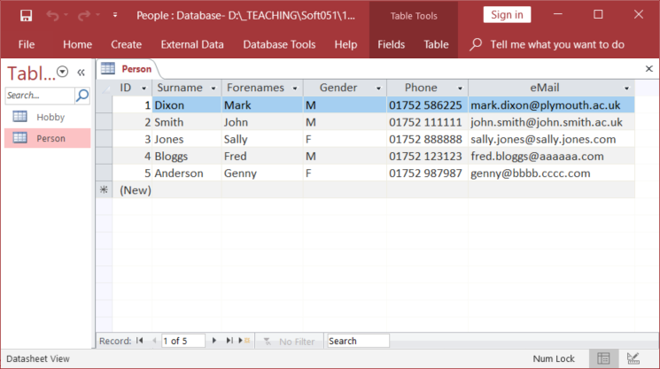
MS Access
☺ All databases provided (web-site resources section)

Slide 13
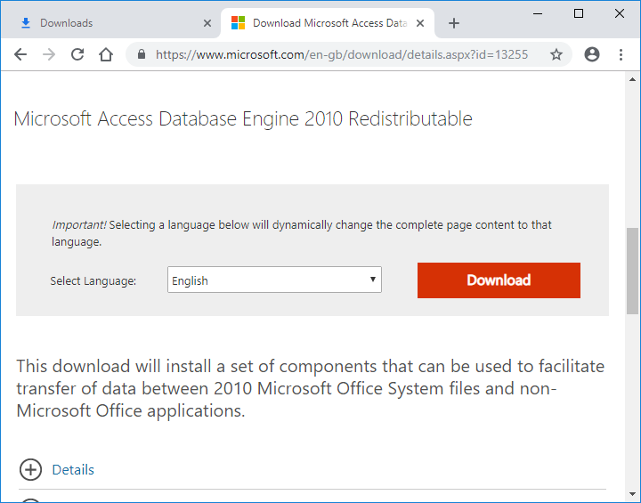
Access Driver (for 32bit Office)
☺ Need to install this: http://www.microsoft.com/en-gb/download/details.aspx?id=13255

Slide 14
Connecting to Databases
Object Linking and Embedding DB (OLEDB)
common database interface
allow you to write code for any DBMS
MS Access
C# code
OLEDB
MS SQL Server
…
DB front end
…

Slide 15
Example: People (code)
People.aspx
<%@ Page Language="C#" %>
<%@ Import Namespace="System.Data.OleDb" %>
<script runat="server">
void Page_Load(){
String cs = "Provider=Microsoft.ACE.OLEDB.12.0;" +
"Data Source=" + Server.MapPath("People.accdb") + ";";
OleDbConnection cn = new OleDbConnection(cs);
OleDbCommand cmd;
OleDbDataReader r;
String h;
cmd = new OleDbCommand("SELECT * FROM Person;", cn);
cn.Open();
r = cmd.ExecuteReader();
h = "";
while(r.Read()){
h = h + r["Surname"];
}
cn.Close();
parData.InnerHtml = h;
}
</script>
Must include database library
connection
command
reader

Slide 16
Example: People (code)
People.aspx
<%@ Page Language="C#" %>
<%@ Import Namespace="System.Data.OleDb" %>
<script runat="server">
void Page_Load(){
String cs = "Provider=Microsoft.ACE.OLEDB.12.0;" +
"Data Source=" + Server.MapPath("People.accdb") + ";";
OleDbConnection cn = new OleDbConnection(cs);
OleDbCommand cmd;
OleDbDataReader r;
String h;
cmd = new OleDbCommand("SELECT * FROM Person;", cn);
cn.Open();
r = cmd.ExecuteReader();
h = "";
while(r.Read()){
h = h + r["Surname"];
}
cn.Close();
parData.InnerHtml = h;
}
</script>
Connection string – identify database
Open connection
Read next record
Read field data
Close connection

Slide 17
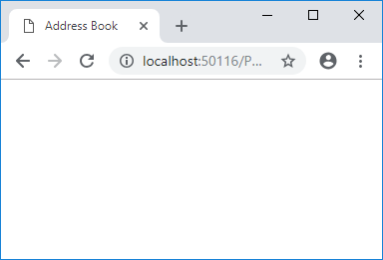
Example: People (r)
People.aspx
r
void Page_Load(){
String cs = "Provider=Microsoft.ACE.OLEDB.12.0;" +
"Data Source=" + Server.MapPath("People.accdb") + ";";
OleDbConnection cn = new OleDbConnection(cs);
OleDbCommand cmd;
OleDbDataReader r;
String h;
cmd = new OleDbCommand("SELECT * FROM Person;", cn);
cn.Open();
r = cmd.ExecuteReader();
h = "";
while(r.Read()){
h = h + r["Surname"];
}
cn.Close();
parData.InnerHtml = h;
}

Slide 18
Example: People (h)
People.aspx
r
void Page_Load(){
String cs = "Provider=Microsoft.ACE.OLEDB.12.0;" +
"Data Source=" + Server.MapPath("People.accdb") + ";";
OleDbConnection cn = new OleDbConnection(cs);
OleDbCommand cmd;
OleDbDataReader r;
String h;
cmd = new OleDbCommand("SELECT * FROM Person;", cn);
cn.Open();
r = cmd.ExecuteReader();
h = "";
while(r.Read()){
h = h + r["Surname"];
}
cn.Close();
parData.InnerHtml = h;
}
h

Slide 19
Example: People (ExecuteReader)
People.aspx
r
void Page_Load(){
String cs = "Provider=Microsoft.ACE.OLEDB.12.0;" +
"Data Source=" + Server.MapPath("People.accdb") + ";";
OleDbConnection cn = new OleDbConnection(cs);
OleDbCommand cmd;
OleDbDataReader r;
String h;
cmd = new OleDbCommand("SELECT * FROM Person;", cn);
cn.Open();
r = cmd.ExecuteReader();
h = "";
while(r.Read()){
h = h + r["Surname"];
}
cn.Close();
parData.InnerHtml = h;
}
h

Slide 20
Example: People (h)
People.aspx
r
void Page_Load(){
String cs = "Provider=Microsoft.ACE.OLEDB.12.0;" +
"Data Source=" + Server.MapPath("People.accdb") + ";";
OleDbConnection cn = new OleDbConnection(cs);
OleDbCommand cmd;
OleDbDataReader r;
String h;
cmd = new OleDbCommand("SELECT * FROM Person;", cn);
cn.Open();
r = cmd.ExecuteReader();
h = "";
while(r.Read()){
h = h + r["Surname"];
}
cn.Close();
parData.InnerHtml = h;
}
h

Slide 21
Example: People (Read)
People.aspx
r
void Page_Load(){
String cs = "Provider=Microsoft.ACE.OLEDB.12.0;" +
"Data Source=" + Server.MapPath("People.accdb") + ";";
OleDbConnection cn = new OleDbConnection(cs);
OleDbCommand cmd;
OleDbDataReader r;
String h;
cmd = new OleDbCommand("SELECT * FROM Person;", cn);
cn.Open();
r = cmd.ExecuteReader();
h = "";
while(r.Read()){
h = h + r["Surname"];
}
cn.Close();
parData.InnerHtml = h;
}
h

Slide 22
Example: People (Surname)
People.aspx
r
void Page_Load(){
String cs = "Provider=Microsoft.ACE.OLEDB.12.0;" +
"Data Source=" + Server.MapPath("People.accdb") + ";";
OleDbConnection cn = new OleDbConnection(cs);
OleDbCommand cmd;
OleDbDataReader r;
String h;
cmd = new OleDbCommand("SELECT * FROM Person;", cn);
cn.Open();
r = cmd.ExecuteReader();
h = "";
while(r.Read()){
h = h + r["Surname"];
}
cn.Close();
parData.InnerHtml = h;
}
h
Dixon

Slide 23
Example: People (Loop)
People.aspx
r
void Page_Load(){
String cs = "Provider=Microsoft.ACE.OLEDB.12.0;" +
"Data Source=" + Server.MapPath("People.accdb") + ";";
OleDbConnection cn = new OleDbConnection(cs);
OleDbCommand cmd;
OleDbDataReader r;
String h;
cmd = new OleDbCommand("SELECT * FROM Person;", cn);
cn.Open();
r = cmd.ExecuteReader();
h = "";
while(r.Read()){
h = h + r["Surname"];
}
cn.Close();
parData.InnerHtml = h;
}
h
Dixon

Slide 24
Example: People (Read)
People.aspx
r
void Page_Load(){
String cs = "Provider=Microsoft.ACE.OLEDB.12.0;" +
"Data Source=" + Server.MapPath("People.accdb") + ";";
OleDbConnection cn = new OleDbConnection(cs);
OleDbCommand cmd;
OleDbDataReader r;
String h;
cmd = new OleDbCommand("SELECT * FROM Person;", cn);
cn.Open();
r = cmd.ExecuteReader();
h = "";
while(r.Read()){
h = h + r["Surname"];
}
cn.Close();
parData.InnerHtml = h;
}
h
Dixon

Slide 25
Example: People (Surname)
People.aspx
r
void Page_Load(){
String cs = "Provider=Microsoft.ACE.OLEDB.12.0;" +
"Data Source=" + Server.MapPath("People.accdb") + ";";
OleDbConnection cn = new OleDbConnection(cs);
OleDbCommand cmd;
OleDbDataReader r;
String h;
cmd = new OleDbCommand("SELECT * FROM Person;", cn);
cn.Open();
r = cmd.ExecuteReader();
h = "";
while(r.Read()){
h = h + r["Surname"];
}
cn.Close();
parData.InnerHtml = h;
}
h
DixonSmith
Dixon

Slide 26
Example: People (Loop)
People.aspx
r
void Page_Load(){
String cs = "Provider=Microsoft.ACE.OLEDB.12.0;" +
"Data Source=" + Server.MapPath("People.accdb") + ";";
OleDbConnection cn = new OleDbConnection(cs);
OleDbCommand cmd;
OleDbDataReader r;
String h;
cmd = new OleDbCommand("SELECT * FROM Person;", cn);
cn.Open();
r = cmd.ExecuteReader();
h = "";
while(r.Read()){
h = h + r["Surname"];
}
cn.Close();
parData.InnerHtml = h;
}
h
DixonSmith

Slide 27
Example: People (Read)
People.aspx
r
void Page_Load(){
String cs = "Provider=Microsoft.ACE.OLEDB.12.0;" +
"Data Source=" + Server.MapPath("People.accdb") + ";";
OleDbConnection cn = new OleDbConnection(cs);
OleDbCommand cmd;
OleDbDataReader r;
String h;
cmd = new OleDbCommand("SELECT * FROM Person;", cn);
cn.Open();
r = cmd.ExecuteReader();
h = "";
while(r.Read()){
h = h + r["Surname"];
}
cn.Close();
parData.InnerHtml = h;
}
h
DixonSmith

Slide 28
Example: People (Surname)
People.aspx
r
void Page_Load(){
String cs = "Provider=Microsoft.ACE.OLEDB.12.0;" +
"Data Source=" + Server.MapPath("People.accdb") + ";";
OleDbConnection cn = new OleDbConnection(cs);
OleDbCommand cmd;
OleDbDataReader r;
String h;
cmd = new OleDbCommand("SELECT * FROM Person;", cn);
cn.Open();
r = cmd.ExecuteReader();
h = "";
while(r.Read()){
h = h + r["Surname"];
}
cn.Close();
parData.InnerHtml = h;
}
h
DixonSmithJones
DixonSmith

Slide 29
Example: People (Loop)
People.aspx
r
void Page_Load(){
String cs = "Provider=Microsoft.ACE.OLEDB.12.0;" +
"Data Source=" + Server.MapPath("People.accdb") + ";";
OleDbConnection cn = new OleDbConnection(cs);
OleDbCommand cmd;
OleDbDataReader r;
String h;
cmd = new OleDbCommand("SELECT * FROM Person;", cn);
cn.Open();
r = cmd.ExecuteReader();
h = "";
while(r.Read()){
h = h + r["Surname"];
}
cn.Close();
parData.InnerHtml = h;
}
h
DixonSmithJones
DixonSmith

Slide 30
Example: People (Read)
People.aspx
r
void Page_Load(){
String cs = "Provider=Microsoft.ACE.OLEDB.12.0;" +
"Data Source=" + Server.MapPath("People.accdb") + ";";
OleDbConnection cn = new OleDbConnection(cs);
OleDbCommand cmd;
OleDbDataReader r;
String h;
cmd = new OleDbCommand("SELECT * FROM Person;", cn);
cn.Open();
r = cmd.ExecuteReader();
h = "";
while(r.Read()){
h = h + r["Surname"];
}
cn.Close();
parData.InnerHtml = h;
}
h
DixonSmithJones
DixonSmith

Slide 31
Example: People (Close)
People.aspx
r
void Page_Load(){
String cs = "Provider=Microsoft.ACE.OLEDB.12.0;" +
"Data Source=" + Server.MapPath("People.accdb") + ";";
OleDbConnection cn = new OleDbConnection(cs);
OleDbCommand cmd;
OleDbDataReader r;
String h;
cmd = new OleDbCommand("SELECT * FROM Person;", cn);
cn.Open();
r = cmd.ExecuteReader();
h = "";
while(r.Read()){
h = h + r["Surname"];
}
cn.Close();
parData.InnerHtml = h;
}
h
DixonSmithJones

Slide 32
Example: People (Display)
People.aspx
r
void Page_Load(){
String cs = "Provider=Microsoft.ACE.OLEDB.12.0;" +
"Data Source=" + Server.MapPath("People.accdb") + ";";
OleDbConnection cn = new OleDbConnection(cs);
OleDbCommand cmd;
OleDbDataReader r;
String h;
cmd = new OleDbCommand("SELECT * FROM Person;", cn);
cn.Open();
r = cmd.ExecuteReader();
h = "";
while(r.Read()){
h = h + r["Surname"];
}
cn.Close();
parData.InnerHtml = h;
}
h
DixonSmithJones
DixonSmithJones

Slide 33
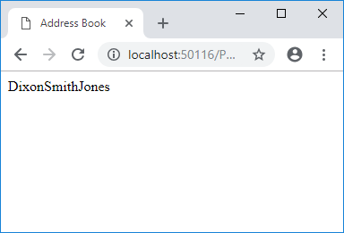
Example: People (html tags)
People.aspx
void Page_Load(){
String cs = "Provider=Microsoft.ACE.OLEDB.12.0;" +
"Data Source=" + Server.MapPath("People.accdb") + ";";
OleDbConnection cn = new OleDbConnection(cs);
OleDbCommand cmd;
OleDbDataReader r;
String h;
cmd = new OleDbCommand("SELECT * FROM Person;", cn);
cn.Open();
r = cmd.ExecuteReader();
h = "";
while(r.Read()){
h = h + r["Surname"];
}
cn.Close();
parData.InnerHtml = h;
}
html by hand
put br tags between data
<br />
Need data on separate lines

Slide 34
Example: People (error)
People.aspx
void Page_Load(){
String cs = "Provider=Microsoft.ACE.OLEDB.12.0;" +
"Data Source=" + Server.MapPath("People.accdb") + ";";
OleDbConnection cn = new OleDbConnection(cs);
OleDbCommand cmd;
OleDbDataReader r;
String h;
cmd = new OleDbCommand("SELECT * FROM Person;", cn);
cn.Open();
r = cmd.ExecuteReader();
h = <br />;
while(r.Read()){
h = h + r["Surname"];
}
cn.Close();
parData.InnerHtml = h;
}
Try putting br tag here
✗
C# does not understand html
Need data on separate lines

Slide 35
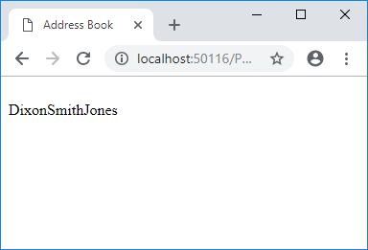
Example: People (html tags)
People.aspx
void Page_Load(){
String cs = "Provider=Microsoft.ACE.OLEDB.12.0;" +
"Data Source=" + Server.MapPath("People.accdb") + ";";
OleDbConnection cn = new OleDbConnection(cs);
OleDbCommand cmd;
OleDbDataReader r;
String h;
cmd = new OleDbCommand("SELECT * FROM Person;", cn);
cn.Open();
r = cmd.ExecuteReader();
h = "<br />";
while(r.Read()){
h = h + r["Surname"];
}
cn.Close();
parData.InnerHtml = h;
}
Need double quotes around tag
(C# sees html as literal string)
runs, but br in wrong place

Slide 36
Example: People (html tags)
People.aspx
void Page_Load(){
String cs = "Provider=Microsoft.ACE.OLEDB.12.0;" +
"Data Source=" + Server.MapPath("People.accdb") + ";";
OleDbConnection cn = new OleDbConnection(cs);
OleDbCommand cmd;
OleDbDataReader r;
String h;
cmd = new OleDbCommand("SELECT * FROM Person;", cn);
cn.Open();
r = cmd.ExecuteReader();
h = "<br />";
while(r.Read()){
h = h + r["Surname"];
}
cn.Close();
parData.InnerHtml = h;
}
Move br tag inside loop.
Which bit of code pulls data
from database?

Slide 37
Example: People (error)
People.aspx
void Page_Load(){
String cs = "Provider=Microsoft.ACE.OLEDB.12.0;" +
"Data Source=" + Server.MapPath("People.accdb") + ";";
OleDbConnection cn = new OleDbConnection(cs);
OleDbCommand cmd;
OleDbDataReader r;
String h;
cmd = new OleDbCommand("SELECT * FROM Person;", cn);
cn.Open();
r = cmd.ExecuteReader();
h = "";
while(r.Read()){
h = h + r["Surname<br />"];
}
cn.Close();
parData.InnerHtml = h;
}
Try putting br tag here
✗
looks for field called Surname<br />
Need data on separate lines

Slide 38
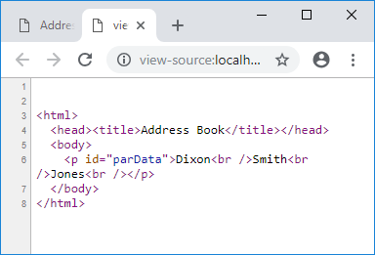
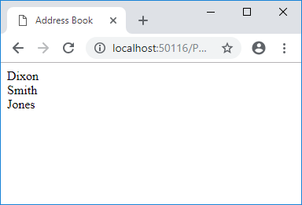
Example: People v2 (html tags)
People.aspx
void Page_Load(){
String cs = "Provider=Microsoft.ACE.OLEDB.12.0;" +
"Data Source=" + Server.MapPath("People.accdb") + ";";
OleDbConnection cn = new OleDbConnection(cs);
OleDbCommand cmd;
OleDbDataReader r;
String h;
cmd = new OleDbCommand("SELECT * FROM Person;", cn);
cn.Open();
r = cmd.ExecuteReader();
h = "";
while(r.Read()){
h = h + r["Surname"] + "<br />";
}
cn.Close();
parData.InnerHtml = h;
}
Move br tag inside loop.
after field data
View Source

Slide 39
Embedding html in C#
html must be string (inside double quotes)
follows normal pattern for expressions:
data
data
data
data
h = h + "<b>" + r["Surname"] + "</b>" ;
operator
operator
operator

Slide 40
Embedding html in C# (errors)
h = h + "<i>" r["Gender"] + "</i>";
missing operator
h = h + r["Height"] + </i>";
missing double quote
h = h + <ul> + r["Height"];
html tag must be inside double quotes
h = h + "<ul>" + r["<b>Height"];
looks for field in database called <b>Height

Slide 41
Questions: HTML in C#
Are these correct (assume variables and fields exist)?
g = g + r["Surname<br />"];
h = h + "<ol>" r["Width"];
a = "<p>" + a + "</p>";
html = html + "<img src=‘face.gif’ />";
h = <table> + h + "</table>";
✗
✗
✓
✓
✗

Slide 42
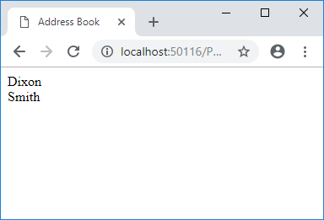
Example: People v3
Display Surname of Male people:
void Page_Load(){
String cs = "Provider=Microsoft.ACE.OLEDB.12.0;" +
"Data Source=" + Server.MapPath("People.accdb") + ";";
OleDbConnection cn = new OleDbConnection(cs);
OleDbCommand cmd;
OleDbDataReader r;
String h;
cmd = new OleDbCommand("SELECT * FROM Person;", cn);
cn.Open();
r = cmd.ExecuteReader();
h = "";
while(r.Read()){
if(r["Gender"].ToString() == "M"){
h = h + r["Surname"] + "<br />";
}
}
cn.Close();
parData.InnerHtml = h;
}

Slide 43
Example: People v4
Display Surname of Male people:
void Page_Load(){
String cs = "Provider=Microsoft.ACE.OLEDB.12.0;" +
"Data Source=" + Server.MapPath("People.accdb") + ";";
OleDbConnection cn = new OleDbConnection(cs);
OleDbCommand cmd;
OleDbDataReader r;
String sql = "SELECT * FROM Person WHERE Gender = 'M';";
String h;
cmd = new OleDbCommand(sql, cn);
cn.Open();
r = cmd.ExecuteReader();
h = "";
while(r.Read()){
h = h + r["Surname"] + "<br />";
}
cn.Close();
parData.InnerHtml = h;
}
SQL statement

Slide 44
SQL: Queries
main purpose of databases:
get information back out: searching
Structured Query Language
dedicated to interacting with databases
3rd Generation Language (such as VB, C#)
code describes how to do task
4th Generation Language (such as SQL)
code describes what to do (not how to do it)

Slide 45
SQL: SELECT statement
SELECT statement
used to get data
can be embedded in C#, via:
… v = "SELECT * FROM [Person]" ... cmd = New OleDbCommand(v, cn);
all fields

Slide 46
SQL: WHERE & ORDER BY
WHERE clause
used to restrict data
SELECT * FROM [People] WHERE [age]>=18;
ORDER BY clause
used to change order of data
SELECT * FROM [People] ORDER BY [Surname];

Slide 47
SQL: strings (text data)
Possible confusion: SELECT * FROM Person WHERE Surname = Smith this will look for field called Smith - gives error need single (SQL) quotes to signify literal text SELECT * FROM Person WHERE Surname = 'Smith'

Slide 48
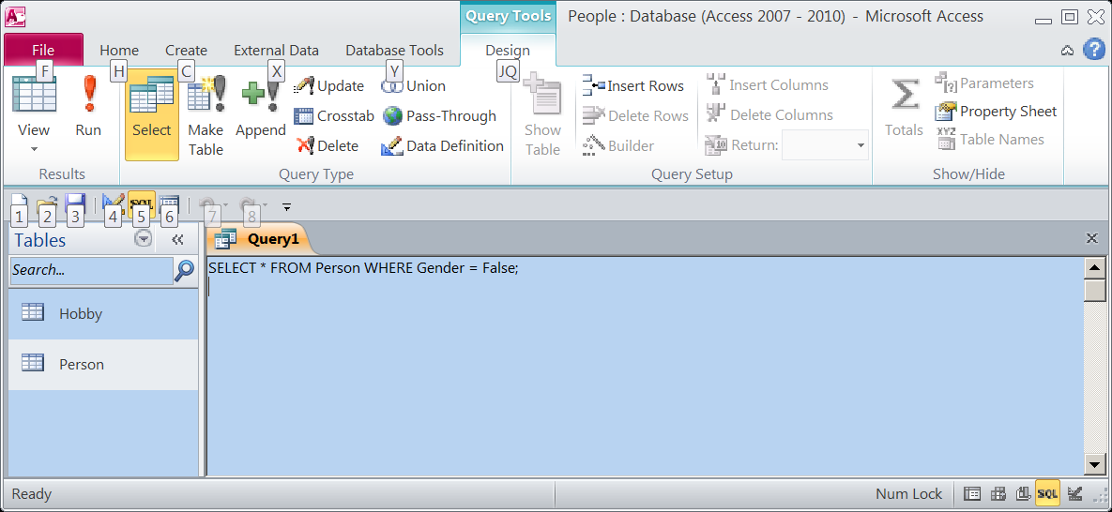
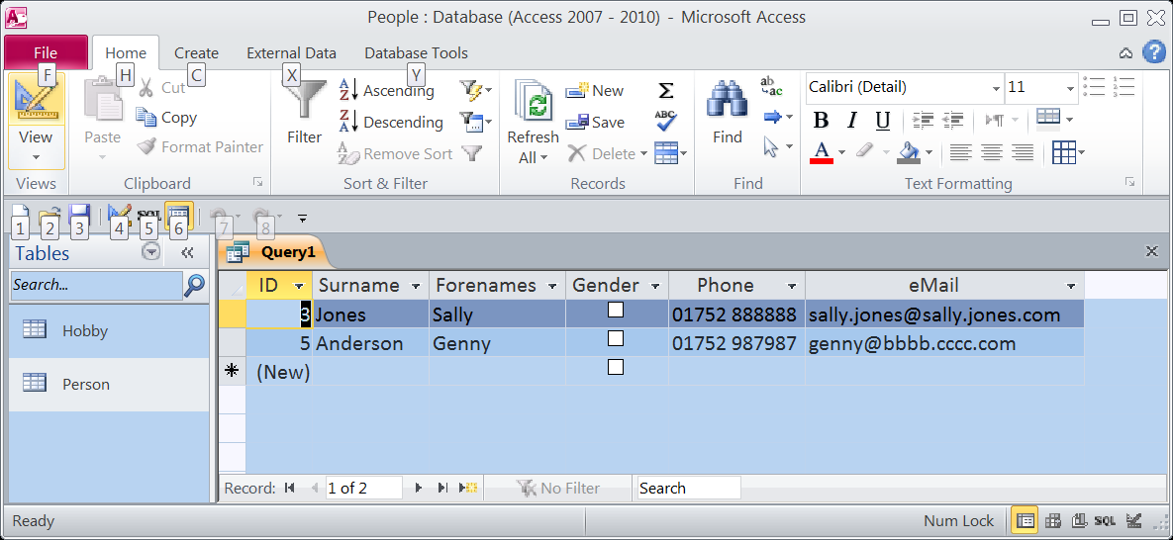
SQL & MS access queries
MS Access
Queries: select data from database
really SQL select statements
can use queries to test SQL code

Slide 49
Questions: SQL
Track
Create an SQL statement to extract Track Title of records by Aerosmith
Track Title | Artist Name | Country
Paranoid | Black Sabbath | UK
Falling in Love | Aerosmith | US
Pink | Aerosmith | US
Love in an Elevator | Aerosmith | US
Smooth Criminal | Alien Ant Farm | US
Meaning of Life | Disturbed | US
The Game | Disturbed | US
Voices | Disturbed | US
Down with the Sickness | Disturbed | US
SELECT [Track Title] FROM Track WHERE [Artist Name] = 'Aerosmith';

Slide 50
Questions: SQL
Track
Create an SQL statement to extract all fields of songs by Disturbed, ordered by track name
Track Title | Artist Name | Country
Paranoid | Black Sabbath | UK
Falling in Love | Aerosmith | US
Pink | Aerosmith | US
Love in an Elevator | Aerosmith | US
Smooth Criminal | Alien Ant Farm | US
Meaning of Life | Disturbed | US
The Game | Disturbed | US
Voices | Disturbed | US
Down with the Sickness | Disturbed | US
SELECT * FROM Track WHERE [Artist Name] = 'Disturbed' ORDER BY [Track Title];

Slide 51
SQL: DISTINCT records
Artist Name
Black Sabbath
Aerosmith
Aerosmith
Aerosmith
Alien Ant Farm
Disturbed
Disturbed
Disturbed
Disturbed
SELECT [Artist Name] FROM [Track];
SELECT DISTINCT [Artist Name] FROM [Track];
Artist Name
Black Sabbath
Aerosmith
Alien Ant Farm
Disturbed

Slide 52
break?

Slide 53
Session Aims & Objectives
Aims
To deal with multiple tables
To write data to databases
Objectives, by end of this week’s sessions, you should be able to:
identify a suitable primary key for a table
identify duplicated data in a single table
split that table to reduce data redundancy, using a suitable foreign key
generate SQL statements to (temporarily) join tables, and use these in your code
use SQL to write data into database

Slide 54
Data Duplication
Look for repeating data:
Track
Track Title | Artist Name | Country
Paranoid | Black Sabbath | UK
Falling in Love | Aerosmith | US
Pink | Aerosmith | US
Love in an Elevator | Aerosmith | US
Smooth Criminal | Alien Ant Farm | US
Meaning of Life | Disturbed | US
The Game | Disturbed | US
Voices | Disturbed | US
Down with the Sickness | Disturbed | US

Slide 55
Problem: Data Duplication
takes up lots of space
can become inconsistent (misspellings)
difficult to change (need to change each instance)
difficult to search (misspellings)

Slide 56
Solution: Normalisation
Part of database design
Process of breaking data down (splitting)
Codd
7 stages of normalisation
Mathematical
Difficult to apply stages
Most professionals do it instinctively

Slide 57
Relations (tables)
Track
Track Title
Paranoid
Falling in Love | Aerosmith | US
Pink | Aerosmith | US
Love in an Elevator | Aerosmith | US
Smooth Criminal | Alien Ant Farm | US
Meaning of Life | Disturbed | US
The Game | Disturbed | US
Voices | Disturbed | US
Down with the Sickness | Disturbed | US
Artist Name | Country
Black Sabbath | UK

Slide 58
Relations (tables)
Track
Artist
Track Title
Paranoid
Falling in Love | Aerosmith | US
Pink | Aerosmith | US
Love in an Elevator | Aerosmith | US
Smooth Criminal | Alien Ant Farm | US
Meaning of Life | Disturbed | US
The Game | Disturbed | US
Voices | Disturbed | US
Down with the Sickness | Disturbed | US
Artist ID
1
ID | Artist Name | Country
1 | Black Sabbath | UK
Artist Name | Country
Black Sabbath | UK

Slide 59
Relations (tables)
Track
Artist
Track Title
Paranoid
Falling in Love
Pink | Aerosmith | US
Love in an Elevator | Aerosmith | US
Smooth Criminal | Alien Ant Farm | US
Meaning of Life | Disturbed | US
The Game | Disturbed | US
Voices | Disturbed | US
Down with the Sickness | Disturbed | US
Artist ID
1
ID | Artist Name | Country
1 | Black Sabbath | UK
2 | Aerosmith | US
ID | Artist Name | Country
1 | Black Sabbath | UK
Aerosmith | US
2

Slide 60
Relations (tables)
Track
Artist
Track Title
Paranoid
Falling in Love
Pink
Love in an Elevator | Aerosmith | US
Smooth Criminal | Alien Ant Farm | US
Meaning of Life | Disturbed | US
The Game | Disturbed | US
Voices | Disturbed | US
Down with the Sickness | Disturbed | US
Artist ID
1
2
2
ID | Artist Name | Country
1 | Black Sabbath | UK
2 | Aerosmith | US

Slide 61
Relations (tables)
Track
Artist
Track Title
Paranoid
Falling in Love
Pink
Love in an Elevator
Smooth Criminal | Alien Ant Farm | US
Meaning of Life | Disturbed | US
The Game | Disturbed | US
Voices | Disturbed | US
Down with the Sickness | Disturbed | US
Artist ID
1
2
2
2
ID | Artist Name | Country
1 | Black Sabbath | UK
2 | Aerosmith | US

Slide 62
Relations (tables)
Track
Artist
Track Title
Paranoid
Falling in Love
Pink
Love in an Elevator
Smooth Criminal
Meaning of Life | Disturbed | US
The Game | Disturbed | US
Voices | Disturbed | US
Down with the Sickness | Disturbed | US
Artist ID
1
2
2
2
3
ID | Artist Name | Country
1 | Black Sabbath | UK
2 | Aerosmith | US
3 | Alien Ant Farm | US

Slide 63
Relations (tables)
Track
Artist
Track Title
Paranoid
Falling in Love
Pink
Love in an Elevator
Smooth Criminal
Meaning of Life
The Game | Disturbed | US
Voices | Disturbed | US
Down with the Sickness | Disturbed | US
Artist ID
1
2
2
2
3
4
ID | Artist Name | Country
1 | Black Sabbath | UK
2 | Aerosmith | US
3 | Alien Ant Farm | US
4 | Disturbed | US

Slide 64
Relations (tables)
Track
Artist
Track Title
Paranoid
Falling in Love
Pink
Love in an Elevator
Smooth Criminal
Meaning of Life
The Game
Voices | Disturbed | US
Down with the Sickness | Disturbed | US
Artist ID
1
2
2
2
3
4
4
ID | Artist Name | Country
1 | Black Sabbath | UK
2 | Aerosmith | US
3 | Alien Ant Farm | US
4 | Disturbed | US

Slide 65
Relations (tables)
Track
Artist
Track Title
Paranoid
Falling in Love
Pink
Love in an Elevator
Smooth Criminal
Meaning of Life
The Game
Voices
Down with the Sickness | Disturbed | US
Artist ID
1
2
2
2
3
4
4
4
ID | Artist Name | Country
1 | Black Sabbath | UK
2 | Aerosmith | US
3 | Alien Ant Farm | US
4 | Disturbed | US

Slide 66
Relations (tables)
Foreign Key
Primary Key
Track
Artist
Track Title | Artist ID
Paranoid | 1
Falling in Love | 2
Pink | 2
Love in an Elevator | 2
Smooth Criminal | 3
Meaning of Life | 4
The Game | 4
Voices | 4
Down with the Sickness | 4
ID | Artist Name | Country
1 | Black Sabbath | UK
2 | Aerosmith | US
3 | Alien Ant Farm | US
4 | Disturbed | US

Slide 67
Question: Keys
Country
Continent
Name | Population | Land Mass | ContID
UK | 60776238 | 241590 | 1
Spain | 40448191 | 499542 | 1
Germany | 82400996 | 349223 | 1
Egypt | 80335036 | 995450 | 2
Kenya | 36913721 | 569250 | 2
China | 1321851888 | 9326410 | 3
ID | Name
1 | Europe
2 | Africa
3 | Asia
Name a Primary Key
Name a Foreign Key
ID in the Continent table
ContID in the Country table

Slide 68
People Database (with Hobbies)
Person
ID | Surname | Forenames | Phone | email
1 | Dixon | Mark | 01752 232556 | mark.dixon@plymouth.ac.uk
2 | Smith | John | 01752 111111 | john.smith@john.smith.ac.uk
3 | Jones | Sally | 01752 888888 | sally.jones@sally.jones.com
4 | Bloggs | Fred | 01752 123123 | fred.bloggs@aaaaaa.com
5 | Anderson | Genny | 01752 987987 | genny@bbbb.cccc.com
Hobby
HobbyID | Description | PersonID
1 | Archery | 1
2 | Herpetology | 1
3 | Music | 1
4 | Football | 2
5 | Rugby | 2
6 | Hitting people with swords | 1

Slide 69
Entity-relationship diagrams
Each table in db
stores details of entity
shown as rectangular box
Person
Hobby
Relationships between tables
represent relationships between entities
shown as line between entities (boxes)

Slide 70
Relationship Types
One-to-one
One-to-many
Many-to-one
Many-to-many
(can't be implemented in relational database)
A
B
A
B
A
B
A
B

Slide 71
Question: Which relationship type?
Person
ID | Surname | Forenames | Phone | email
1 | Dixon | Mark | 01752 232556 | mark.dixon@plymouth.ac.uk
2 | Smith | John | 01752 111111 | john.smith@john.smith.ac.uk
3 | Jones | Sally | 01752 888888 | sally.jones@sally.jones.com
4 | Bloggs | Fred | 01752 123123 | fred.bloggs@aaaaaa.com
5 | Anderson | Genny | 01752 987987 | genny@bbbb.cccc.com
Hobby
HobbyID | Description | PersonID
1 | Archery | 1
2 | Herpetology | 1
3 | Music | 1
4 | Football | 2
5 | Rugby | 2
6 | Hitting people with swords | 1
Person
Hobby

Slide 72
SQL: Joining tables
Two tables
SELECT * FROM Person, Hobby;
Cartesian set
(all record
combinations):

Slide 73
SQL: Joining tables
Two tables
SELECT * FROM Person, Hobby WHERE Person.ID = Hobby.PersonID;
Matching records
ID
Surname
Forenames
Phone
email
HobbyID
Description
PersonID
1
Dixon
Mark
01752 232556
mark.dixon@plymouth.ac.uk
1
Archery
1
1
Dixon
Mark
01752 232556
mark.dixon@plymouth.ac.uk
2
Herpetology
1
1
Dixon
Mark
01752 232556
mark.dixon@plymouth.ac.uk
3
Music
1
1
Dixon
Mark
01752 232556
mark.dixon@plymouth.ac.uk
6
Hitting people with swords
1
2
Smith
John
01752 111111
john.smith@john.smith.ac.uk
4
Football
2
2
Smith
John
01752 111111
john.smith@john.smith.ac.uk
5
Rugby
2

Slide 74
SQL: Joining tables
SELECT ID, Surname FROM Person, Hobby WHERE Person.ID = Hobby.PersonID;
ID
Surname
1
Dixon
1
Dixon
1
Dixon
1
Dixon
2
Smith
2
Smith

Slide 75
Question: SQL Joining Tables
Write an SQL query to join the following:
Track
Artist
Track Title | Artist ID
Paranoid | 1
Falling in Love | 2
Pink | 2
Love in an Elevator | 2
Smooth Criminal | 3
Meaning of Life | 4
The Game | 4
Voices | 4
Down with the Sickness | 4
ID | Artist Name | Country
1 | Black Sabbath | UK
2 | Aerosmith | US
3 | Alien Ant Farm | US
4 | Disturbed | US

Slide 76
SQL: More
Loads more:
group by
aggregate functions: average, count
inner joins
outer joins (left and right)
Have a look at:
http://www.w3schools.com/sql/sql_join.asp

Slide 77
Example: Person v1 (Specification)
User requirement:
Display people's details from database online
need 2 pages:
smith
jones
dixon
jones
sally
list of people
person's details

Slide 78

Example: PeopleList.aspx v1
<%@ Page Language="C#" %>
<%@ Import Namespace="System.Data.OleDb" %>
<script runat="server">
void Page_Load(){
String cs = "Provider=Microsoft.ACE.OLEDB.12.0;" +
"Data Source=" + Server.MapPath("People.accdb") + ";";
OleDbConnection cn = new OleDbConnection(cs);
OleDbCommand cmd;
OleDbDataReader r;
String h;
cmd = new OleDbCommand("SELECT * FROM Person;", cn);
cn.Open();
r = cmd.ExecuteReader();
h = "";
while(r.Read()){
h = h + r["Surname"] + "<br />";
}
cn.Close();
parData.InnerHtml = h;
}
</script>
<html>
<head><title></title></head>
<body>
<p id="parData" runat="server"></p>
</body>
</html>

Slide 79
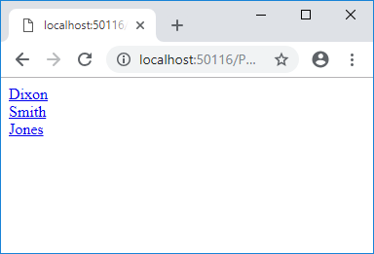
Example: PeopleList.aspx v2
<%@ Page Language="C#" %>
<%@ Import Namespace="System.Data.OleDb" %>
<script runat="server">
void Page_Load(){
String cs = "Provider=Microsoft.ACE.OLEDB.12.0;" +
"Data Source=" + Server.MapPath("People.accdb") + ";";
OleDbConnection cn = new OleDbConnection(cs);
OleDbCommand cmd;
OleDbDataReader r;
String h;
cmd = new OleDbCommand("SELECT * FROM Person;", cn);
cn.Open();
r = cmd.ExecuteReader();
h = "";
while(r.Read()){ h = h + "<a href='Person.aspx?id=" + r["ID"] + "'>";
h = h + r["Surname"] + "</a><br />";
}
cn.Close();
parData.InnerHtml = h;
}
</script>
<html>
<head><title></title></head>
<body>
<p id="parData" runat="server"></p>
</body>
</html>
now links

Slide 80
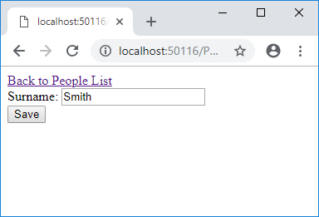
Example: Person.aspx v2
<%@ Page Language="C#" %>
<%@ Import Namespace="System.Data.OleDb" %>
<script runat="server">
void Page_Load(){
String cs = "Provider=Microsoft.ACE.OLEDB.12.0;" +
"Data Source=" + Server.MapPath("People.accdb") + ";";
OleDbConnection cn = new OleDbConnection(cs);
OleDbCommand cmd;
OleDbDataReader r;
String sql = "SELECT * FROM Person WHERE id=" + Request.QueryString["id"];
cmd = new OleDbCommand(sql, cn);
cn.Open();
r = cmd.ExecuteReader();
if(r.Read()){
txtSurname.Value = r["Surname"].ToString();
}
cn.Close();
}
</script>
<html>
<head><title></title></head>
<body>
<a href="PeopleList2.aspx">Back to People List</a><br />
<form runat="server">
Surname: <input id="txtSurname" runat="server" /><br />
<input id="btnSave" type="submit" value="Save" runat="server" />
</form>
</body>
</html>
reads querystring
(from previous page)
displays data for
selected record only

Slide 81
Example: Person v2 (Specification)
User requirement:
Display person’s details from database online
Change surname and save to database

Slide 82
Changing Data
SQL
INSERT: inserts a new record
INSERT INTO Person (Surname, Age) VALUES ('Smith', 21);
UPDATE: makes changes to specified record
UPDATE Person Set Surname = 'Smith', Age = 21 WHERE id = 14;
DELETE: deletes specified record
DELETE FROM Person WHERE id = 14;

Slide 83
WARNING!!
All changes permanent (no undo)
WHERE clause is CRITICAL
DELETE FROM Person;
Will delete ALL records in table

Slide 84
Example: Person.aspx v3
String cs = "Provider=Microsoft.ACE.OLEDB.12.0;" +
"Data Source=" + Server.MapPath("People.accdb") + ";";
OleDbConnection cn = new OleDbConnection(cs);
OleDbCommand cmd;
String sql;
sql = "UPDATE [Person] " +
" SET [Surname] = '" + txtSurname.Value + "'" +
" WHERE id = " + Request.QueryString["id"] + ";"
cmd = new OleDbCommand(sql, cn);
cn.Open();
cmd.ExecuteNonQuery();
cn.Close();

Slide 85
Tutorial Exercise: People
Task 1: Download People database from resources
Task 2: Get the People v1 example (from the lecture) working.
Task 3: Modify your page so that it displays phone number as well as the person's name.
Task 4: Modify your page so that it displays the data in an html table.
Task 5: Modify your page so that records for males are displayed in blue, and records for females are displayed in red.
Task 6: Allow the user to display different genders. You will need to:
Add a form to the page, and three submit buttons
In your code, detect when a button has been pressed (have a look at previous weeks)
Task 7: Modify your page so that the user can type a letter, and only names starting with that letter are displayed.
Task 8: Modify your page so that the user can type a series of numerical digits and only phone numbers containing those digits are displayed.
Task 9: Modify your code so that the user can order the data by surname, or email address (You may want to use a Query String)

Slide 86
Tutorial Exercise: Person
Task 1: Get the Person (v1) example from the lecture working.
Task 2: Modify your code, so that forename is displayed as well as surname (use a table).
Task 3: Get the Person (v2 and v3) example from the lecture working.
Task 3: Modify your code, so that a line of text is displayed confirming that data has been saved.
Task 4: Modify your code, so that an add button is included, which allows a new record to be added.
Task 5: Modify your code, so that a delete button is included, which allows the current record to be deleted.

Slide 87
Tutorial Exercise: Music
Task 1: Download (from resources) or Create the Music database (from the lecture) with the Track and Artist tables.
Task 2: Create a web page to display a list of Artists.
Task 4: Change that web page, so that each artist name is a link to another page, which displays all the tracks by that artist. Hint: Use query strings to pass the artist ID between pages.

